Slide 1
Battle Of Neighbourhoods
Identifying Most Common Business to Invest in Mumbai
Data Source :
Wiki Page -> For Location :- https://en.wikipedia.org/wiki/List_of_neighbourhoods_in_Mumbai
Four Square API -> For Venues and Venue Categories

Slide 2
Methodology
Extracting Location from the Wiki Page
Using Four Square API to Get Venue and Venue Categories
Merging data from two sources on Latitude and Longitude common in the two Dataframe
Creating onehot for locations across all venue category
Taking mean of the venue category across area and location
Identifying top venues of different location
Creating 6 Cluster of dataset

Slide 3
Libraries and Packages used
Pandas
Numpy
Geopy
Scikit Learn
Matplotlib
BS4
Folium

Slide 4
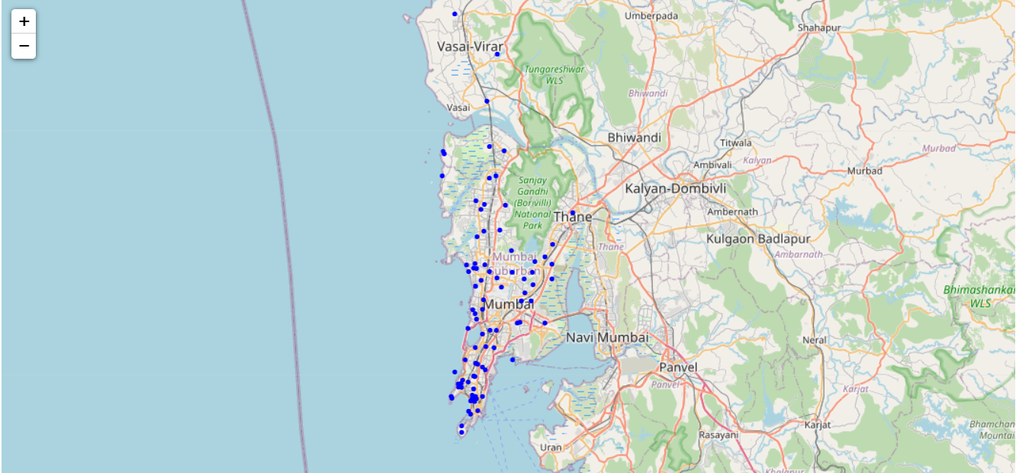
Analysis
Mumbai Locations on Map

Slide 5
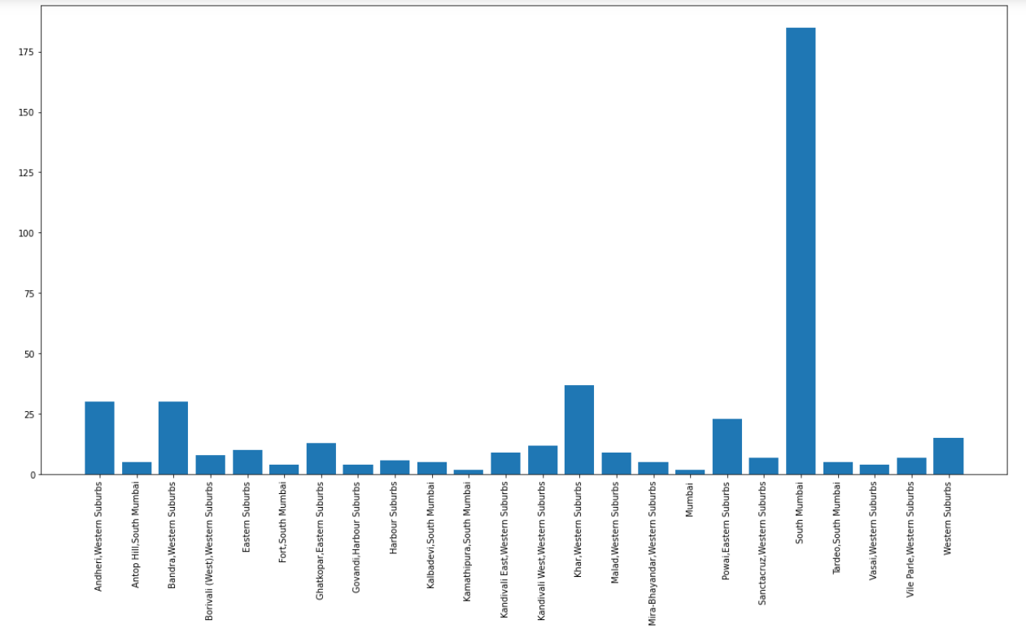
Number of Venues in Different Location
Most Diverse Location
South Mumbai
Andheri Western Suburbs
Bandra West
Khar West

Slide 6
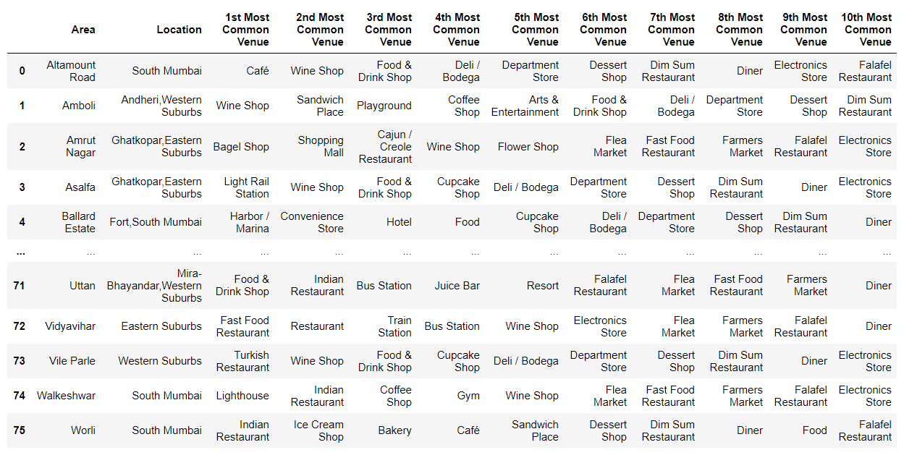
Locations Vs Most Common Venues
Most Common Venues
Restaurants,
Cafes,
Wine Shop,
Ice Cream Shop

Slide 7
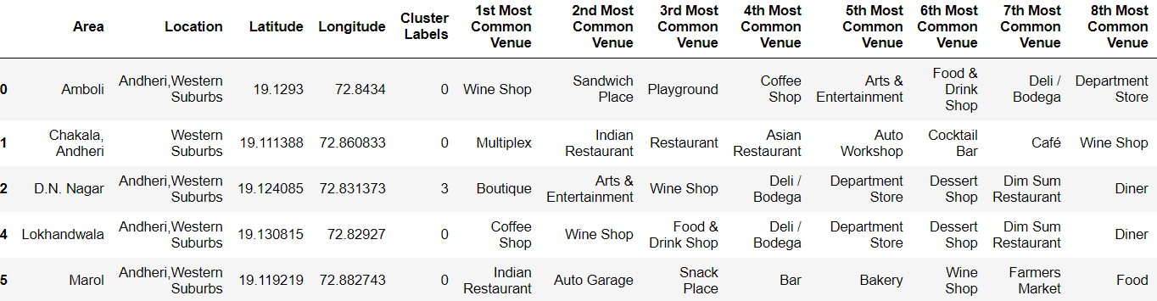
Most Common Venues in Andheri
Most Common Venues in Andheri
Restaurants
Coffee Shop
Eateries

Slide 8
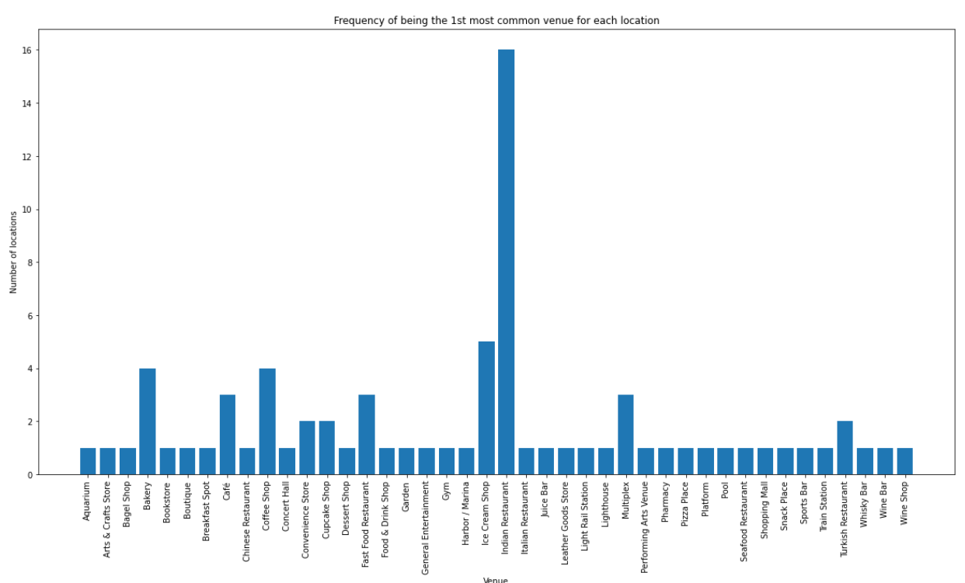
Frequency Of First Most Common Venue in Different location
Order of First Most Common Venue Frequency in Mumbai across different location
Indian Restaurants
Ice Cream Shop
Coffee Shop
Bakery
Cafe

Slide 9
Result
After analysis it could be identified Indian Restaurant is the most common venues in most of the areas and few area where it could be opened are Andheri, South Mumbai, Khar etc.

